Slide 1


Slide 2

Introduction to
Data Science
(IT4142E)

Slide 3
Contents
Lecture 1: Overview of Data Science
Lecture 2: Data crawling and preprocessing
Lecture 3: Data cleaning and integration
Lecture 4: Exploratory data analysis
Lecture 5: Data visualization
Lecture 6: Multivariate data visualization
Lecture 7: Machine learning
Lecture 8: Big data analysis
Lecture 9: Capstone Project guidance
Lecture 10+11: Text, image, graph analysis
Lecture 12: Evaluation of analysis results

Slide 4
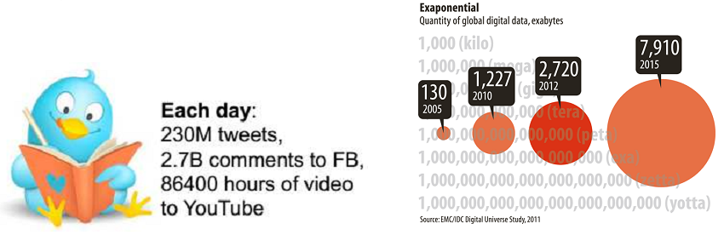
Why ML?
Data mining, inference, prediction
ML & DM provides an efficient way to make intelligent systems/services.
ML provides vital methods and a foundation for Big Data.

Slide 5

What is Machine Learning?
Machine Learning (ML) is an active subfield of Artificial Intelligence.
ML seeks to answer the question [Mitchell, 2006]
How can we build computer systems that automatically improve with experience, and what are the fundamental laws that govern all learning processes?
Some other views on ML:
Build systems that automatically improve their performance [Simon, 1983].
Program computers to optimize a performance objective at some task, based on data and past experience [Alpaydin, 2020]

Slide 6
A learning machine
We say that a machine learns if the system reliably improves its performance P at task T, following experience E.
A learning problem can be described as a triple (P, T, E).
ML is close to and intersects with many areas.
Computer Science,
Statistics, Probability,
Optimization,
Psychology, Neuroscience,
Computer Vision,
Economics, Biology, Bioinformatics, …

Slide 7
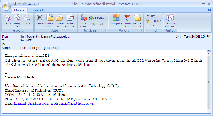


Some real examples (1)
Spam filtering for emails
T: filter/predict all emails that are spam.
P: the accuracy of prediction, that is the percentage of emails that are correctly classified into normal/spam.
E: set of old emails, each with a label of spam/normal.
Spam?
No
Yes

Slide 8

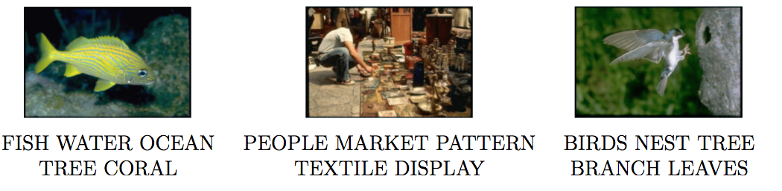
Some real examples (2)
Image tagging
T: give some words that describe the meaning of a picture.
P: ?
E: set of pictures, each has been labelled with a set of words.

Slide 9
What does a machine learn?
A mapping (function):
x: observations (data), past experience
y: prediction, new knowledge, new experience,…
A model (mô hình)
Data are often supposed to be generated from an unknown model. (Dữ liệu thường được tạo ra bởi một mô hình nào đó)
Learning a model means learning the parameters of that model. (Học một mô hình có nghĩa là học/tìm những tham số của mô hình đó)

Slide 10
Where does a machine learn from?
Learn from a set of training examples (training set, tập học, tập huấn luyện) { {x₁, x₂, …, x_{N}}; {y₁, y₂,…, y_{M}} }
x_{i} is an observation (quan sát, mẫu, điểm dữ liệu) of x in the past.
y_{j} is an observation of y in the past, often called label (nhãn) or response (phản hồi) or output (đầu ra).
After learning:
We obtain a model, new knowledge, or new experience (f).
We can use that model/function to do prediction or inference for future observations, e.g.,

Slide 11
Two basic learning problems
Supervised learning (học có giám sát): learn a function y = f(x) from a given training set {x₁, x₂, …, x_{N}, y₁, y₂,…, y_{N}} so that y_{i} ≅ f(x_{i}) for every i.
Classification (categorization, phân loại, phân lớp): if y only belongs to a discrete set, for example {spam, normal}
Regression (hồi quy): if y is a real number
Unsupervised learning (học không giám sát): learn a function y = f(x) from a given training set {x₁, x₂, …, x_{N}}.
y can be a data cluster
y can be a hidden structure
y can be a trend
Other: semi-supervised learning, reinforcement learning, …

Slide 12

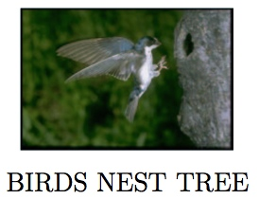
Supervised learning: classification
Multiclass classification (phân loại nhiều lớp): when the output y is one of the pre-defined labels {c₁, c₂, …, c_{L}} (mỗi đầu ra chỉ thuộc 1 lớp, mỗi quan sát x chỉ có 1 nhãn)
Spam filtering: y in {spam, normal}
Financial risk estimation: y in {high, normal, no}
Discovery of network attacks: ?
Multilabel classification (phân loại đa nhãn): when the output y is a subset of labels (mỗi đầu ra là một tập nhỏ các lớp; mỗi quan sát x có thể có nhiều nhãn)
Image tagging: y = {birds, nest, tree}
Sentiment analysis

Slide 13

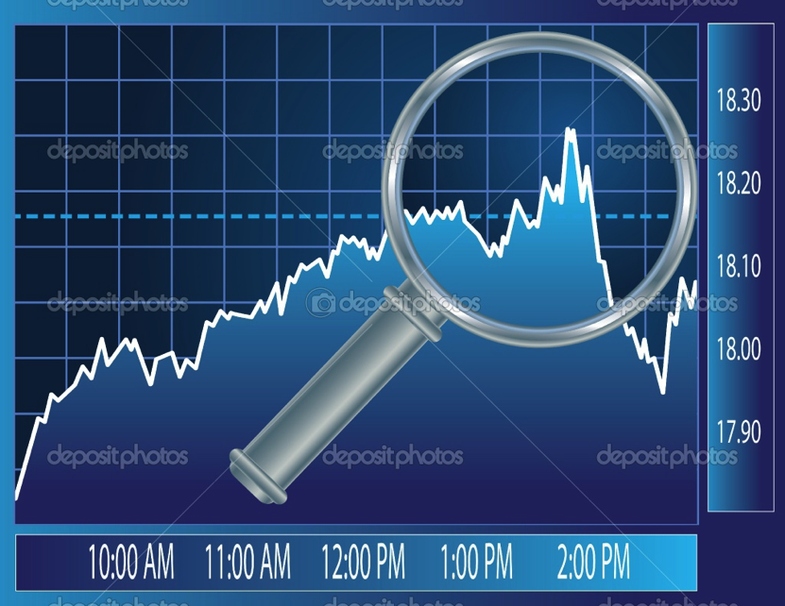
Supervised learning: Regression
Prediction of stock indices

Slide 14
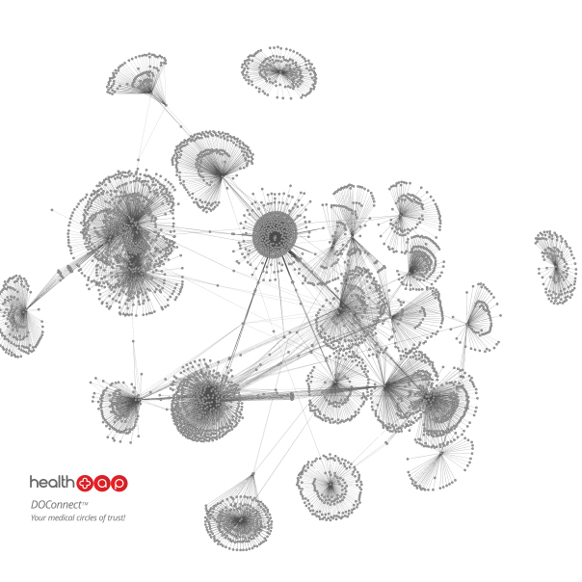
Unsupervised learning: examples (1)
Clustering data into clusters
Discover the data groups/clusters
Community detection
Detect communities in online social networks

Slide 15
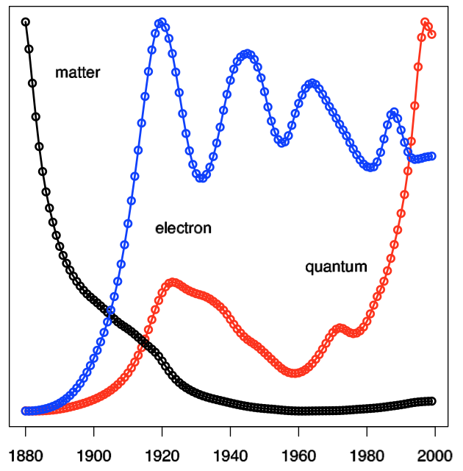
Unsupervised learning: examples (2)
Trends detection
Discover the trends, demands, future needs of online users

Slide 16
Design a learning system (1)
Some issues should be carefully considered when designing a learning system.
Select a training set:
The training set plays the key role in the effectiveness of the system.
Do the observations have any label?
The training observations should characterize the whole data space →good for future predictions.
Determine the type of the function to be learned
F: X → {0,1}
F: X → set of labels/tags
F: X → R

Slide 17
Design a learning system (2)
Select a representation for the function: (model)
Linear?
A neural network?
A decision tree? …
Select a good algorithm to learn the function:
Ordinary least square? Ridge regression?
Back-propagation?
Random forest?

Slide 18
ML: some issues (1)
Learning algorithm
Under what conditions the chosen algorithm will (asymtotically) converge?
For a given application/domain and a given objective function, what algorithm performs best?
No-free-lunch theorem [Wolpert and Macready, 1997]: if an algorithm performs well on a certain class of problems then it necessarily pays for that with degraded performance on the set of all remaining problems.
No algorithm can beat another on all domains. (không có thuật toán nào luôn hiệu quả nhất trên mọi miền ứng dụng)

Slide 19
ML: some issues (2)
Training data
How many observations are enough for learning?
Whether or not does the size of the training set affect performance of an ML system?
What is the effect of the disrupted or noisy observations?

Slide 20
ML: some issues (3)
Learnability:
The goodness/limit of the learning algorithm?
What is the generalization (tổng quát hoá) of the system?
Predict well new observations, not only the training data.
Avoid overfitting.

Slide 21
Overfitting (quá khớp, quá khít)
Function h is called overfitting [Mitchell, 1997] if there exists another function g such that:
g might be worse than h for the training data, but
g is better than h for future data.
A learning algorithm is said to overfit relative to another one if it is more accurate in fitting known data, but less accurate in predicting unseen data.
Overfitting is caused by many factors:
The function/model is too complex or have too much parameters.
Noises or errors are present in the training data.
The training size is too small, not characterizing the whole space.

Slide 22
Overfitting
Error
Test error
Training error
Underfitting
Good model
Overfitting
Simple
Good
Too complex

Slide 23
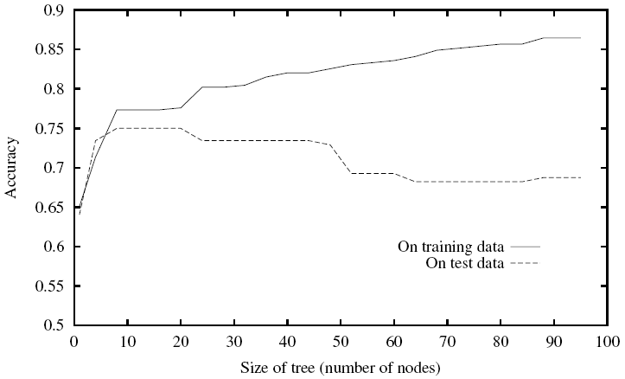
Overfitting: example
Increasing the size of a decision tree can degrade prediction on unseen data, even though increasing the accuracy for the training data.
[Mitchell, 1997]

Slide 24
Overfitting: Regularization
Among many functions, which one can generalize best from the given training data?
Generalization is the main target of ML.
Predict unseen data well.
Regularization: a popular choice
f(x)
x
(Picture from http://towardsdatascience.com/multitask-learning-teach-your-ai-more-to-make-it-better-dde116c2cd40)

Slide 25
References
Alpaydin E. (2020). Introduction to Machine Learning. The MIT Press.
Mitchell, T. M. (1997). Machine learning. McGraw Hill.
Mitchell, T. M. (2006). The discipline of machine learning. Carnegie Mellon University, School of Computer Science, Machine Learning Department.
Simon H.A. (1983). Why Should Machines Learn? In R. S. Michalski, J. Carbonell, and T. M. Mitchell (Eds.): Machine learning: An artificial intelligence approach, chapter 2, pp. 25-38. Morgan Kaufmann.
Valiant, L. G. (1984). A theory of the learnable. Communications of the ACM, 27(11), 1134-1142.
Wolpert, D.H., Macready, W.G. (1997), "No Free Lunch Theorems for Optimization", IEEE Transactions on Evolutionary Computation 1, 67.

Slide 26
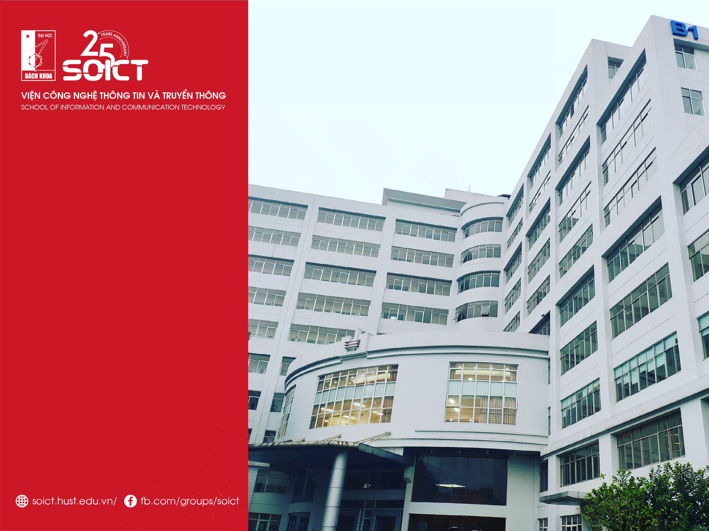
Thank you for​ your attentions!​

